Slide 1
«studentname»
«232725»
«Block_B»
[photo]
Learning Log
Year 2
Block B
Hyperlink
Hyperlink
Hyperlink

Slide 2

How To Use
This Template
As a student at Breda University of Applied Sciences studying to become a professional, you are required to provide evidence that demonstrates your professional learning and growth during the block. This template is intended to provide you with a well-structured and organised format for doing this effectively. Keep in mind that certain competencies may require you to update your evidence every week, and others may have only be relevant during a particular week or two.
With the evidence you present here teachers should get a clear and comprehensive overview of your progress, how you’ve engaged with feedback, as well as your general attitude and performance as a student and as an aspiring professional developer.
Note that number and size of text boxes and how they are organized on each slide may be modified as needed. It is up to you to decide what layout is most effective for the content you are providing. You may also add slides if needed, but try to be as economical as possible, i.e. quality over quantity. Focus on the things that are the most significant and meaningful.
You are also free to stylise this template to improve the graphic design and visual appeal, but please remember its purpose: to provide evidence of your progress towards becoming a professional developer. Changes should only enhance and extend the information, and may never subtract. I.e. do not delete anything or change the order of things. If in doubt, seek approval from your teachers!

Slide 3
Learning Log
Structure
Section A - My Plan Must be completed in week 1
Your plan describes your goals for the block. Starting with where you are right now, where do you want to be at the end of the block? I.e. what role(s) will you take responsibility for, and how will you demonstrate progress relevant to the ILOs for this block? What tasks and deliverables are best aligned with your role and the project brief?
Section B - ILO’s Must be completed in week 8, but should be updated regularly
This is where you link your evidence to each of the Intended Learning Outcomes of this block.
Section C - Weekly Log Must be updated every week
This is simply a log (journal) of what you do each day, and what you learn from it. It is your responsibility to update this regularly and frequently. Be sure to include working links to any specific evidence you are referencing (and make sure that you share your docs with the teaching team). Note: some of the required information may be captured in production documents such as your work log or peer reviews.
In such cases, you simply need to provide links to those artifacts and may include any explanatory comment or reflection you feel is appropriate.
(Some reflection is almost always a good idea as it provides the foundation for Section C.)
Section D - Reflection Must be completed in week 8
Summative reflection on your progress during the block including a critical assessment of everything you did and learned during the block. This is a comprehensive review of everything recorded in Section B, evaluated against the goals and planning laid out in Section A.
Section A
Starting this block
Goals
Section B
ILO section
Week log section
Section C
Block reflection

Slide 4
Section A
In the first week, the student sets ambitious, S.M.A.R.T. goals in alignment with the project brief, their chosen role(s), content of the assessment rubric and their personal long-term goals
A
Goal Setting
Notes:
MUST BE UPDATED EVERY WEEK
This is simply a log (journal) of what you do each day, and what you learn from it. It is your responsibility to update this regularly and frequently. Be sure to include working links to any specific evidence you are referencing (and make sure that you share your docs with the teaching team). Note: some of the required information may be captured in production documents such as your work log or peer reviews.
In such cases, you simply need to provide links to those artifacts and may include any explanatory comment or reflection you feel is appropriate.
(Some reflection is almost always a good idea as it provides the foundation for Section C.)

Slide 5
A
Where am I starting?
1/2
Feedback from previous assessment – Hi Petar, you dropped quite some points due to insufficient evidencing and the quality of the work you handed in. For some components, it is clear that you relied on GenAI to complete the work for you, which does not lead to quality work. I believe you have the skills and knowledge to do better, so please put more trust in your own work next time!
...
My interpretation / key takeaways
I had some mistake but I don’t think the grade really respresent the work that we put into that block as whole we worked every week on the final deliverables there was some smiising aprt but as whole we put a lot of work
Notes:
Copy and paste the feedback from the previous block’s assessment into the text box.
Copy and paste the bullet points you listed on the “Lessons Learned” page in section C of your last block’s log.
Compare the grade you gave yourself with the grade you received, and reevaluate or restate your feeling on your current level of progress.

Slide 6
A
What is my plan?
2/2
What I learned last block - Previous block’s grade
3.0
To work in Together better spread work into equal parts
My current level of progress
I feel I am progresing each day even though the grade does not represent it I feel goibng better everyday
Links
...
Notes:
Copy and paste the feedback from the previous block’s assessment into the text box.
Copy and paste the bullet points you listed on the “Lessons Learned” page in section C of your last block’s log.
Compare the grade you gave yourself with the grade you received, and reevaluate or restate your feeling on your current level of progress.

Slide 7
A
What are my goals?
1/1
S | Specific: Be specific when determining your goal. The more specific the better. Putting a real figure to your goal helps make it measurable. When specific and measurable your subconscious mind cannot override your goals, they become achievable.
M | Measurable: This where you define a measurable and meaningful goal. It’s important to be able to track your progress. Without meaningful and measurable goals which you can track it’s easy to lose heart and focus.
A | Achievable: Choosing realistic and short-term goals helps them be more achievable. Long-term goals can be larger and take more time to achieve. Planning smaller short-term goals as steps to larger long-term goals assists in achieving them.
R | Relevant: Each goal you set must be in line with your core values and in harmony with what YOU want out of life. Contradictions in values and goals leads to frustration and loss of motivation. Designing your goals with the expectation of your personal success.
T | Time-Bound: Setting a time limit on achieving a goal makes it measurable. When a goal is measurable you can SEE your progress and support your motivation and commitment. Giving your goal a time limit assists you in holding yourself accountable to its completion.
E | Evaluate: By evaluating your goals on a regular basis you will be much more likely to achieve them. It is easy to forget about long-term goals if they are not revisited from time to time. This also helps you assess if the goal you are working on remains in line with your core values and helps you measure your progress.
R | Readjust: Readjustments occur when goals are determined, through re-evaluation, to be misaligned with your values or long-term goals. This is especially helpful when you have been unable to achieve a goal in the time limits you set. This gives you the opportunity to modify your approach and increase your chances of success.
I am taking responsibility for (if multiple add in percentages)
Specific: Attend weekly meetings to assist the company in defining clear AI agent goals.Measurable: Track progress towards understanding the company’s AI needs and your grades.Achievable: Balance meeting contributions with study efforts for good grades.Relevant: Focus aligns with AI expertise and academic success.Time-Bound: Achieve project and grade goals by the end of the block.Evaluate: Review progress weekly to stay aligned with goals.Readjust: Adjust priorities as needed to balance project and grades.
90%: Passing the block with a good grade by dedicating most of my focus to studying and coursework.
10%: Helping the client realize their AI agent goals by contributing to weekly meetings and project discussions.
Notes:
Describe your goals for this block using the SMARTER method. Make sure they are clear, relevant, have a measurable outcome, and can be recorded. Consider how well do they align with the role(s) you wish to take, and with the requirements given in the project brief. Think about the objectives you plan to choose, or that are mandated by the project. Are there any competencies that you need to focus on?
For each goal, find concrete examples of tasks you expect to undertake that will demonstrate this within the project for the block. Make sure the plan has an outcome that can be tracked and assessed. Make sure you have a clearly stated target for each goal. If you are unsure of how to demonstrate something, ask for help from your teachers.

Slide 8
Section B
B
Progress Log
Notes:
MUST BE UPDATED EVERY WEEK
This is simply a log (journal) of what you do each day, and what you learn from it. It is your responsibility to update this regularly and frequently. Be sure to include working links to any specific evidence you are referencing (and make sure that you share your docs with the teaching team). Note: some of the required information may be captured in production documents such as your work log or peer reviews.
In such cases, you simply need to provide links to those artifacts and may include any explanatory comment or reflection you feel is appropriate.
(Some reflection is almost always a good idea as it provides the foundation for Section C.)

Slide 9
1
Week 1 - Log
1/2
Reflection
What did you do?
How did the week go?
The week was productive, with most tasks completed as planned. Some minor setbacks (e.g., canceled "Morphological Operation" task) did not significantly impact the overall progress.
What went well?
Masking and coloring tasks for all images were completed effectively and efficiently.
Valuable insights were gained from the football analytics podcast by Sarah Rudd, enhancing your understanding of the application of data science in football.
Successfully completed Week 1 notebooks.
What didn’t go so well?
I thought the coloring is going to be done by someone else not by us it took a lot of time and didn’t translate to anything learned
What did you learn?
How to apply masking and coloring techniques using Fiji for image segmentation tasks.
How did your efforts in applying iterative critical thinking this week contribute to improving your approach to the project? (ILO 2.6)
Iterative critical thinking helped refine the approach for masking and coloring tasks, ensuring consistent quality across all images.
What could be added as an Action point looking forward to next week?
Plan a structured timeline to ensure consistent progress across all notebooks and tasks.
What goal(s) did you set for this week?
Make task 1 and color the necessary images
Finish all of the notebooks for week 1
What have you actually been able to do?
Successfully completed the masking and coloring of all the required images on time.
Completed the "Basics" and "Thresholding and Filtering" notebooks.
Worked on personal development by listening to a podcast on football analytics with Sarah Rudd.
Showcase the evidence of your progress (production artifacts, short descriptions-links-pictures animated gifs, etc.)
Masking tasks and datasets: GitHub Repository.
Completed "Basics" notebook: Basics Notebook.
Completed "Thresholding and Filtering" notebook: Thresholding and Filtering Notebook.

Slide 10
1
Week 1 - Feedback
2/2
Team, individual, peer, workshop feedback
[Reviewer] Feedback
Response to Feedback
Click for feedback delivery techniques!

Slide 11
2
Week 2 - Log
1/2
What did you do?
Reflection
What goal(s) did you set for this week?
Task 2 focusing on image processing.
Finish self-study topics, including morphological operations, edge detection, and image segmentation.
What have you actually been able to do?
Completed labeling and finalizing images for Task 1.
Progressed significantly in Task 2, including edge detection and crop detection, though adjustments are needed to refine the pixel detection.
Completed self-study topics on morphological operations, edge and contour detection
Showcase the evidence of your progress (production artifacts, short descriptions-links-pictures animated gifs, etc.)
Morphological Operations: Notebook Edge and Contour Detection: Notebook Image Segmentation: Notebook Peer Review Task: Peer Review Document Task 2 Progress: Task 2 Notebook
How did the week go?
The week was highly productive, with most tasks completed successfully. However, further adjustments are required to improve the crop detection algorithm for Task 2.
What went well?
Successfully completed the labeling and self-study topics as planned. Peer review was thorough and completed on time
What didn’t go so well?
The crop detection algorithm needs refinement to adapt properly for accurate pixel detection.
What did you learn?
Advanced concepts in morphological operations, edge detection, and image segmentation.
How did your efforts in applying iterative critical thinking this week contribute to improving your approach to the project? (ILO 2.6)
Iterative critical thinking enabled progress in edge and crop detection by identifying and addressing gaps in the algorithm
What could be added as an Action point looking forward to next week?
Refine the crop detection algorithm to achieve accurate pixel-level segmentation. Start exploring potential challenges in upcoming tasks to plan proactively.

Slide 12
2
Week 2 - Feedback
2/2
Team, individual, peer, workshop feedback
[Reviewer] Feedback
Response
Click for feedback delivery techniques!

Slide 13
3
Week 3 - Log
1/2
What did you do?
Reflection
What goal(s) did you set for this week?
finalize Task 2 adjustments
complete the peer review for Mask 2, and start Task 3.
Additionally, I aimed to update my documentation and evidence logs while progressing in object detection and mask segmentation.
What have you actually been able to do?
I successfully completed Task 2 adjustments
the peer review for Mask 2, and started Task 3.
I also updated my learning log and made progress in object detection and mask segmentation tasks.
However, some adjustments in Task 2 need further refinement, causing delays.
Evidence: Task 3. Link: GitHub Peer Review Feedback
What could be added as an Action point looking forward to next week?
Finalize all remaining adjustments for Task 2.
Establish clear benchmarks for completing Task 3 without further delays.
Allocate specific time for iterative testing to avoid bottlenecks in the future.
How did the week go?
The week went moderately well. I completed key tasks but faced challenges with Task 2 adjustments, which slowed my progress in starting Task 3.
What went well?
Completing Task 2 adjustments.
Successfully completing the peer review for Mask 2.
Updating my learning log and documentation.
What didn’t go so well?
Task 2 required more iterations than anticipated, delaying progress on Task 3.
Adjustments for Task 2 are still not perfect and need further refinement.
What did you learn?
I learned how to refine logic for complex tasks. Specifically, I successfully developed a method to create a cropping square for Task 2, improving precision and usability for subsequent image processing.
How did your efforts in applying iterative critical thinking this week contribute to improving your approach to the project? (ILO 2.6)
Through iterative critical thinking, I was able to develop the logic for creating a cropping square, a key improvement for Task 2

Slide 14
3
Week 3 - Feedback
2/2
Team, individual, peer, workshop feedback
[Ron] Feedback
Response: We need to put more work into to other taks to finish faster
Click for feedback delivery techniques!

Slide 15
4
Week 4 - Log
1/2
What did you do?
Reflection
What goal(s) did you set for this week?
My goals were to resolve issues with Task 3
finalize patching for Task 4
process the 2023 and 2024 datasets
including validation and training data preparation.
What have you actually been able to do?
Worked with a colleague to resolve an issue with Task 3 and made progress on the code.
Cropped images and completed the first phase of patching, though further improvements are still needed.
Created notebooks for extracting validation and training datasets but encountered issues with preprocessing documentation.
Evidence:
Task 3 Code Progress
What could be added as an Action point looking forward to next week?
Complete patching for Task 4.
Resolve issues with 2024 dataset extraction and validation preparation.
Focus on documenting the preprocessing pipeline for easier troubleshooting and workflow alignment.
How did the week go?
The week was productive in certain areas, but I am still behind in completing patching and resolving issues with dataset preprocessing.
What went well?
Developed a script for matching masks and images for the 2023 dataset.
Made progress on Task 3 and started patching for Task 4.
Successfully rearranged folders and added the 2024 dataset.
What didn’t go so well?
Patching remains incomplete and requires further refinement.
Encountered issues with extracting the 2024 dataset using the existing code.
Lack of clear documentation for preprocessing slowed progress.
What did you learn?
I learned the importance of testing code in various scenarios to ensure compatibility across datasets. Additionally, I gained more experience in scripting for image-matching processes.
How did your efforts in applying iterative critical thinking this week contribute to improving your approach to the project? (ILO 2.6)
Applying iterative critical thinking allowed me to refine the mask-matching process and start the patching phase. However, further iterations are needed to resolve dataset preprocessing challenges fully.

Slide 16
4
Week 4 - Feedback
2/2
Team, individual, peer, workshop feedback
[Alexhi] Feedback
You and Ron are falling behind on the assigned tasks. It’s crucial to put in more effort to catch up and meet the project deadlines.
Response: We know that is why we are staying extra hours in uni to cath up with everything that we missed
Click for feedback delivery techniques!

Slide 17
5
Week 5 - Log
1/2
What did you do?
Reflection
What goal(s) did you set for this week?
My goals were to finalize the patching function for the 2023 dataset
I planned to create a template for Task 5 and begin training a model.
What have you actually been able to do?
Successfully redid the patching function for the 2023 dataset.
Managed and split the 2024 dataset correctly and created a function for separating datasets.
Fixed the patching process for the 2024 validation set.
Installed a new environment and updated Nvidia drivers.
Started training a model for Task 5 but faced issues with poor model performance.
Evidence
Task 4 - Dataset Management
Task 4 - Validation Dataset Preparation
What could be added as an Action point looking forward to next week?
Focus on debugging and improving the model masks to address training issues.
Prioritize completing the integration of tasks for dataset preprocessing and model training
How did the week go?
This week was particularly challenging due to traveling and holiday commitments. Although I managed to work on key tasks, the extra workload highlighted how far behind I am.
What went well?
Completed patching for the 2023 dataset and fixed patching for the 2024 validation set.
Successfully separated the 2024 dataset and addressed cropping issues.
Installed the necessary environment and drivers to continue the work.
What didn’t go so well?
Model training for Task 5 produced poor results, showing that the masks and preprocessing steps need improvement.
I’m still far behind on integrating everything into a cohesive workflow.
Holiday distractions further slowed my pace.
What did you learn?
I learned how to troubleshoot image-related issues and improved my understanding of dataset separation and validation processes.
How did your efforts in applying iterative critical thinking this week contribute to improving your approach to the project? (ILO 2.6)
By iterating on the patching function and dataset management, I identified and resolved key issues, especially for the 2024 validation set. However, despite these improvements, the overall progress is not enough to catch up.

Slide 18
5
Week 5 - Feedback
2/2
Team, individual, peer, workshop feedback
[Panayotis] Feedback "I hope you guys figure it out during Christmas, but honestly, I don’t think you’ll be able to catch up on time."
Response We appreciate your concern, Panayotis, but we are determined to catch up. We will use the Christmas period to focus and make significant progress to get back on track. We are confident we can turn things around and meet the deadlines.
Click for feedback delivery techniques!

Slide 19
6
Week 6 - Log
1/2
What did you do?
Reflection
What goal(s) did you set for this week?
Improve the Task 5 model by increasing F1 scores and addressing image quality issues.
Build pipelines for Tasks 6, 7, and 8, incorporating morphological operations and skeletonization while refining logic for summarizing data.
Achieve better scores in Kaggle submissions by experimenting with new logic and debugging.
Begin understanding and advancing Tasks 9, 10, and 11 while discussing hyperparameter tuning with colleagues.
What have you actually been able to do? Next slide
Eviudence:
Training the Model - Task 5
Pipeline for Task 6 and 7
Task 8
Kaggle submission
How did the week go?
The week was highly productive but also had its share of challenges. I made significant progress across Tasks 5, 6, 7, and 8, achieved great results in Kaggle, and improved my understanding of inference and pipeline-building. However, debugging overfitting issues took a lot of time, and there’s still much to finalize for the remaining tasks.
What went well?
Increased the F1 score of Task 5 to 80 and improved image output quality.
Successfully completed the pipelines for Tasks 6 and 7, integrating advanced logic and morphological operations.
Finalized the Task 8 pipeline and made multiple submissions to Kaggle, reaching 5th place with a score of 4.
Fixed inference code and transitioned to more efficient outputs, which greatly improved the workflow for later tasks.
Collaborated with colleagues to refine logic and hyperparameter tuning, setting a strong foundation for Tasks 9, 10, and 11.
Despite tight timelines, I was able to juggle debugging, development, and submission tasks effectively to produce tangible results.

Slide 20
6
Week 6 - Log
1/2
What did you do?
Reflection
What have you actually been able to do?
Achieved an F1 score of 80 in the second iteration of Task 5 model training, significantly improving image outputs.
Fixed inference code issues and transitioned to more workable outputs, which led to better results in subsequent steps.
Completed and optimized the pipelines for Tasks 6 and 7, including logic for summarizing branch-top data and refining operations with morphological techniques.
Successfully built and finalized the pipeline for Task 8, submitting multiple iterations to Kaggle, with the best submission achieving 5th place and a score of 4.
Initiated progress on Task 9 by building foundational understanding and advancing preprocessing steps.
Made advancements in hyperparameter tuning for future tasks by collaborating with a colleague to leverage existing resources effectively.
What could be added as an Action point looking forward to next week?
Fully finalize Tasks 9, 10, and 11 with clear benchmarks and priorities.
Further optimize training and debugging processes to reduce delays and improve results.
Consolidate all progress into a cohesive workflow to avoid backlogs in later stages.
What didn’t go so well?
Spent an entire day just to understand that my inference code was overfitting, which delayed other work.
Long training times for models limited the number of iterations I could perform for further improvement.
Still behind on fully integrating Tasks 9, 10, and 11, which will require focused attention next week.
What did you learn?
I learned how to effectively debug and refine inference code to address overfitting issues. Additionally, I gained valuable experience in optimizing pipelines and developing competition-ready solutions, which contributed to measurable progress across multiple tasks.
How did your efforts in applying iterative critical thinking this week contribute to improving your approach to the project? (ILO 2.6)
Iterative critical thinking played a pivotal role in the skeletonization and branch-top summarization logic, which directly contributed to achieving a high score on the Kaggle leaderboard. Refining these aspects ensured more accurate outputs, ultimately boosting the model's performance and placing me in 5th place.

Slide 21
6
Week 6 - Feedback
2/2
Team, individual, peer, workshop feedback
[Panayotis] Feedback "Great job!"
[Zsombo] Feedback "Great job! We thought you weren’t going to make it, but you proved us wrong.“
Response Thank you! And as they say, "They hate us because they ain't us!" 😎
Click for feedback delivery techniques!

Slide 22
7
Week 7 - Log
1/2
What did you do?
Reflection
What goal(s) did you set for this week?
Fine-tune the controller for Task 9 and get it running smoothly.
Finalize and debug the wrapper for Task 10 while ensuring all dependencies were working.
Tackle Task 11 by making reinforcement learning (RL) functional, setting up callbacks, and training models.
Start working on Task 12 to fix and test the PID controller.
Improve my Kaggle submissions for Task 8 by tweaking the logic for specific sectors.
Get closer to completing Tasks 9, 10, and 11 while pushing for better performance overall.
What have you actually been able to do? Next slide
Showcase the evidence of your progress (production artifacts, short descriptions-links-pictures animated gifs, etc.)
Simulation for Task 9
Wrapper Refinements - Task 10
Task 11 RL Implementation
How did the week go?
It was an intense week, but overall, it went well. I tackled a lot of complex tasks, from reinforcement learning and PID controller testing to wrapper debugging. Some moments were frustrating, like dealing with lengthy training times and dependency issues, but the sense of accomplishment kept me motivated. I also had a few wins, like making the RL work and resolving tricky controller issues.
What went well?
I successfully fine-tuned the Task 9 controller, which now works smoothly after tweaking speed and step size parameters.
The wrapper for Task 10 came together nicely after I refined the logic and fixed some dependency issues.
In Task 11, I got the RL working, added callbacks to track reward functions, and trained models with updated learning rates.
Task 12 saw major progress as I fixed and tested the PID controller, resolving issues with the z-axis.
Despite a lot of effort, even though the Kaggle score for Task 8 didn’t improve, I refined the logic and can confidently say this is the best I can achieve with my current methods.

Slide 23
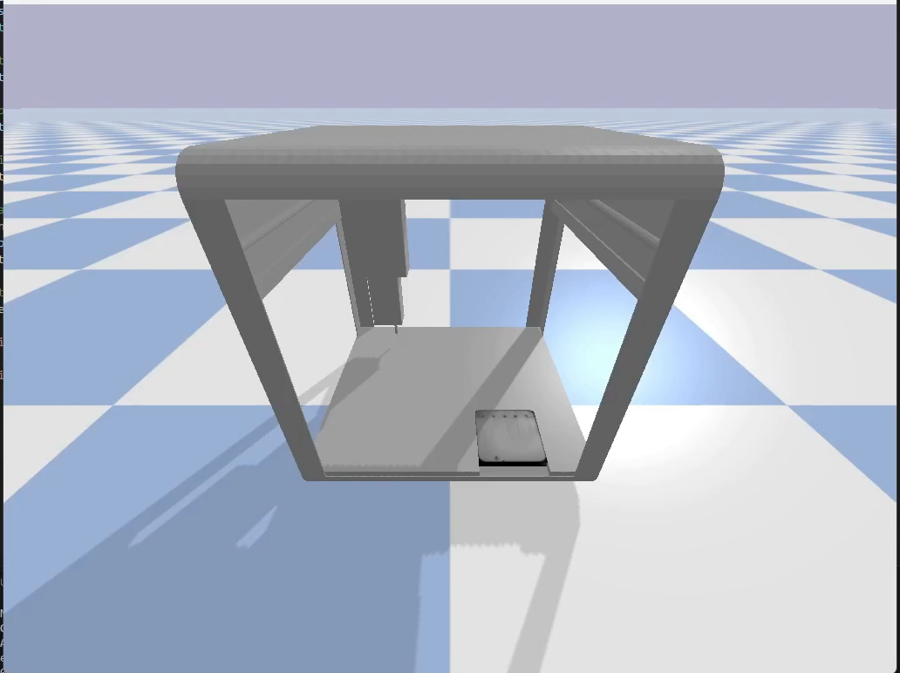
7
Week 7 - Log
1/2
What did you do?
Reflection
What have you actually been able to do?
I managed to fine-tune the controller for Task 9 by adjusting speed and step size, which made it run more smoothly.
In Task 10, I spent much time working on the wrapper, tweaking the logic, and reviewing dependencies to ensure everything was in place.
For Task 11, I made reinforcement learning functional, added callbacks to track the reward function, and trained multiple models with updated learning rates and parameters, some running up to 2 million steps.
I made good progress on Task 12 by fixing and testing the PID controller, and resolving some tricky z-axis issues.
For Task 8, I adjusted the logic for sector 5 to refine submissions, though the Kaggle score didn’t change.
I also caught up on previous learning logs and helped others while waiting for some of my tasks to run.
What didn’t go so well?
Everything went smoothly even though I had some issues with the controller
What did you learn?
I also learned a lot about reinforcement learning, callbacks, and debugging controllers. Collaboration was another key takeaway, as helping others gave me a fresh perspective on some of my own tasks.
How did your efforts in applying iterative critical thinking this week contribute to improving your approach to the project? (ILO 2.6)
Overall made a great progress this week with my best iteration in Task 10 changing the wrapper logic to have more simple reward function.
Also the fine tunning of hyperparameters of the PID helped with getting the best accuracy possible
What could be added as an Action point looking forward to next week?
Finish my presentation
Do Task 13 on any PID or RL
Finish Evidencing

Slide 24
7
Week 7 - Feedback
2/2
Team, individual, peer, workshop feedback
Ron Tabuchov Feedback
Response: We need to keep going the block is not finished yet.
Click for feedback delivery techniques!

Slide 25
8
Week 8 - Log
1/2
What did you do?
Reflection
What goal(s) did you set for this week?
Begin and make significant progress on Task 13, including building a computer vision (CV) pipeline and PID controller.
Finalize and deliver Task 15 by preparing and presenting a solid presentation.
Wrap up all evidencing and learning logs to ensure my documentation was complete.
What have you actually been able to do?
Submitted my final Kaggle submission for Task 8 and achieved 7th place on the public leaderboard, which I reviewed with my colleagues.
Worked extensively on Task 13 by creating a CV pipeline class and successfully implementing a PID controller. While the RL integration faced some challenges, progress was made.
Completed and presented Task 15, receiving positive feedback from Jason, who suggested adding more error analysis.
Finished evidence and learning logs for the block.
Participated in the final meeting and watched other presentations, gaining insights and inspiration.
Evidence: Task 13 CV Pipeline
Task 13 PID Controller
Task 15 Presentation
How did the week go?
The week went well overall, with solid progress made on multiple tasks. While I faced some difficulties with the RL aspect of Task 13, I was able to finish the CV pipeline and PID controller. The presentation went smoothly, and the feedback was positive. Watching other presentations and participating in the final wrap-up gave me closure for the block.
What went well?
Achieved 7th place on the Kaggle leaderboard, which was a proud moment for me.
Successfully created and implemented a CV pipeline class for Task 13, making my PID controller more efficient.
Finalized the presentation for Task 15, which was well-received.
Managed to stay on track with evidencing and learning logs despite the busy schedule.
What didn’t go so well?
Encountered some issues with the RL integration in Task 13 due to inconsistencies in the shape of the petri dish, which I didn’t manage to fully resolve.
What did you learn? Next slide
How did your efforts in applying iterative critical thinking this week contribute to improving your approach to the project? (ILO 2.6)
What could be added as an Action point looking forward to next week?

Slide 26
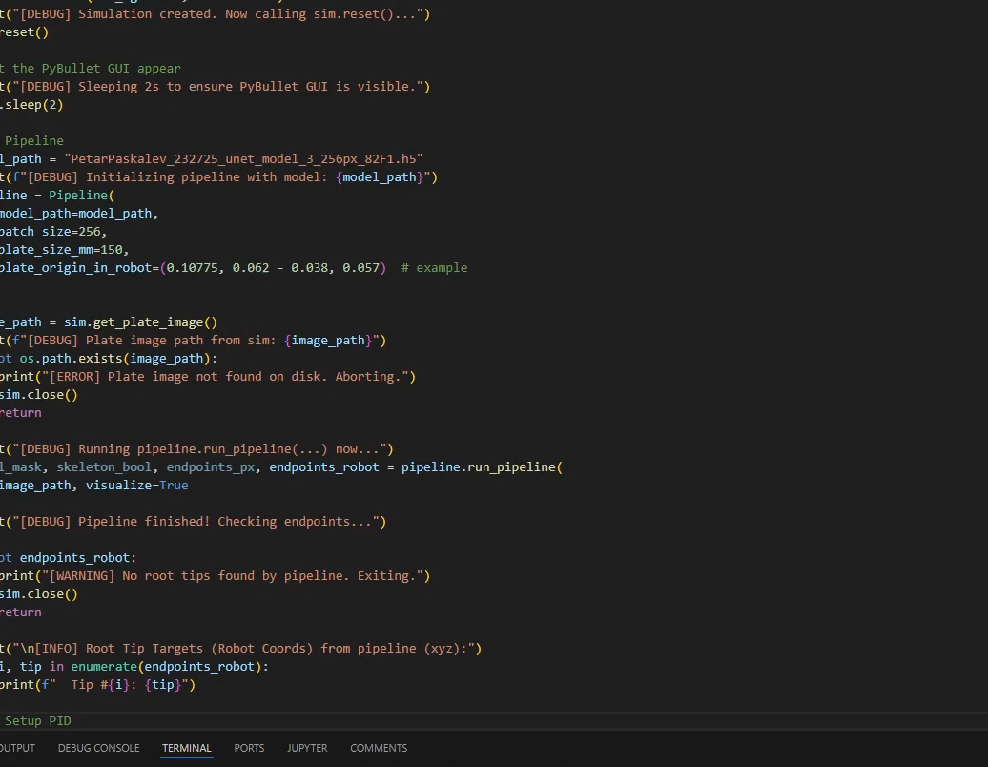
8
Week 8 - Log
1/2
What did you do?
Reflection
Evidence:
What did you learn?
Learned a lot about how to streamline processes like the PID controller by integrating them into a CV pipeline. Lastly, presenting and receiving feedback reminded me of the value of reflecting on my work and identifying areas for improvement.
How did your efforts in applying iterative critical thinking this week contribute to improving your approach to the project? (ILO 2.6)
Refining the PID controller and CV pipeline step by step allowed me to produce a robust solution. Additionally, by iteratively testing my Kaggle submissions, I was able to achieve a respectable 7th place on the leaderboard.
What could be added as an Action point looking forward to next week?
Build on the feedback received from presentations to improve my ability to showcase and explain my work effectively.

Slide 27
8
Week 8 - Feedback
2/2
Team, individual, peer, workshop feedback
[Reviewer] Feedback
Response
Click for feedback delivery techniques!

Slide 28
Section C
C
Progress
Intended Learning Outcomes
Notes:
MUST BE COMPLETED IN WEEK 8, BUT SHOULD BE UPDATED REGULARLY
This is where you link your evidence to each of the Intended Learning Outcomes of this block.

Slide 29
ILO 1
1
Professional practice
The student can collaborate (internationally) in multidisciplinary teams with different levels of knowledge in the field of data use and applications. They can set up and execute projects in collaboration with stakeholders and team members. They can act as a sounding board in discussions with team members, customers, users and experts. They strive for a good balance between input of their own vision and additional expertise of others. They are able to lead a team.

Slide 30
ILO 1
Professional practice
The student can collaborate (internationally) in multidisciplinary teams with different levels of knowledge in the field of data use and applications.
1/1
1.6
Presentation. The student demonstrates the ability to convert project findings into a coherent and structured presentation. The student is able to communicate the project findings in a professional manner adapted to the audience.
pre-requisites | A: 2 points | B: 2 points | C: 2 points | D: 2 points | E: 2 points
Student submitted a complete learning log, work log and self-assessment rubric. Student presented their findings during the final block presentation. | The student creates well-designed slides where all content is easy to read, and visual elements such as tables, figures, and images are clear and appropriately sized. The student avoids excessive text, ensuring slides are concise and focused. Proper citations are included when needed on individual slides, and each slide has a clear title and is numbered for reference. Plots are presented with properly labeled axes, and images are of suitable resolution for clarity. | The student demonstrates thorough preparation, starts on time, adheres to the time limit, and delivers a well-paced and complete presentation. | The student responds to questions clearly and accurately, demonstrating a solid understanding of the topic and providing thoughtful, well-reasoned answers. | The student delivers the presentation confidently, maintaining eye contact, using clear language, and engaging the audience throughout. | The student organizes the presentation logically, ensuring that the problem, approach, and results are easy to follow and well-explained.
Working_log, link to recorded video , Presentation , self_assessment-rubric | Clear figures like segmentation outputs, cropped images, and skeletonization results are used. For example, the "Task 3" slide clearly shows the segmentation process with bounding boxes and a Viridis map for better clarity. Plots and results are labeled, such as F1 scores in the pipeline and leaderboard visuals. All images, like those of cropped and skeletonized plants, are clear and appropriately sized. Presentation | My whole presentation was less than 15 minutes, there was time left to discuss questions with the mentors and my colleagues. recorded video , Presentation | I responded to the questions effectively in around 12 minutes into the video. Throughout my presentation, I showed my thought process and how I came up with the ideas that I did. recorded video , Presentation | I tried my best to entertain and give a solid foundation for what I actually did. Maintained eye contact with the mentors and with my colleagues while using clear language to demonstrate my knowledge in the topic. recorded video | Logical Structure: The slides follow a clear flow: problem definition (e.g., segmentation issues in Task 3), approach (e.g., PID controller adjustments in Task 13), and results (e.g., 7th place on Kaggle leaderboard). Clarity in Explanation: Each section, like segmentation or reinforcement learning, is broken down into clear steps with concise descriptions and supporting visuals, making the approach easy to follow. Results Presentation: Outcomes, such as leaderboard scores and improved segmentation outputs, are highlighted effectively, tying back to the approach and problem.

Slide 31
ILO 2
2
Personal development & Academic practice
The student applies relevant (research) methods and techniques in combination with relevant and adequate argumentation. They can reflect on (business) processes and their role in them, both theoretically and practically, by constantly evaluating their own actions and adapting them with input from others. They can translate the result of the reflection into concrete personal learning objectives.

Slide 32
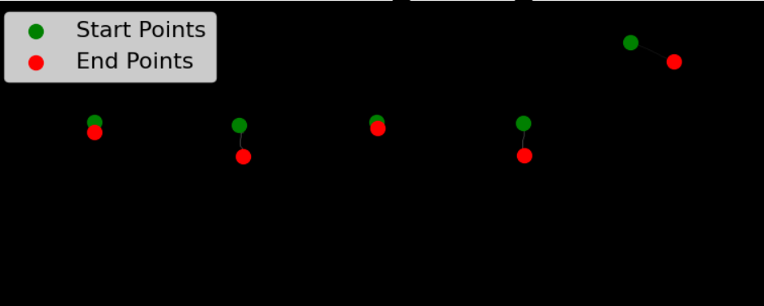
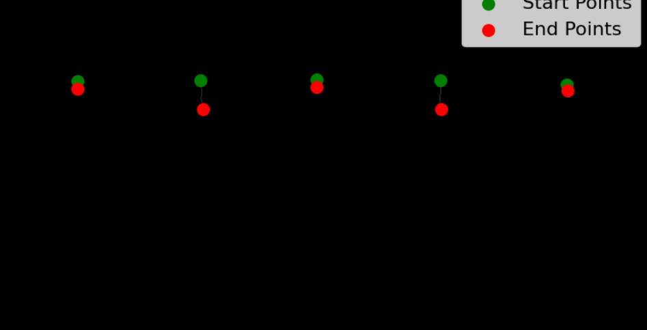
ILO 2
Personal development
The student can reflect on (business) processes and their role in them, both theoretically and practically, by constantly evaluating their own actions and adapting them with input from others. They can translate the result of the reflection into concrete personal learning objectives.
1/1
2.6
Critical Thinking. The student is able to apply critical thinking skills during the block on the project and the learning experience.
pre-requisites | A: 10 points
Student submitted a complete learning log, work log and self-assessment rubric. Student presented their findings during the final block presentation. | The student demonstrates the ability to critically evaluate their approach to solving computer vision tasks by reflecting on daily progress through work log entries and weekly progress through the learning log. This includes error analysis, identifying challenges, identifying edge cases, justifying decisions, listing assumptions and planning next steps to iteratively improve the project. The student consistently applies these reflections to optimize workflow and enhance problem-solving strategies, with the iterative improvement clearly identifiable in the worklog and learning log section B. The student discusses three crucial iterations in the final block presentation in detail.
self_assessment-rubric , Working_log, recorded video , Presentation | My presentation clearly shows how I critically evaluated my approach throughout the block. The work log and learning log show that I reflected daily and weekly on my progress. I identified challenges, like segmentation issues and model overfitting, and planned how to solve them. For example, I adjusted step sizes and morphological operations score thresholds and iteratively improved workflows. I also highlighted three key iterations: First most important critical part is to actually divide the image into 5 parts assuming there is only 1 plant per sector . Fixed and refined the PID controller in Task 13, mainly fixing the z-axis to y-axis in order the inoculation to be in the right spot. Fine-tuning reinforcement learning and Task 8 adjusting the 5th sector so I do not get random noise in image 14 plant 5. Which made it possible to get 7th place in the Kaggle competition. recorded video , Presentation
Before adjusting
Refined predictions

Slide 33
ILO 5
5
Domain Knowledge
Domain Knowledge. The student has such knowledge of and insight into one or more domains that they can function as a discussion partner for experts. They are able to quickly immerse themselves in new domains and associated professional networks.

Slide 34
ILO 5
Domain Knowledge
The student has such knowledge of and insight into one or more domains that they can function as a discussion partner for experts.
1/1
5.1
Domain Knowledge. The student demonstrates a solid understanding of the project domain by accurately describing the client and outlining the problem using appropriate domain-specific terminology.
pre-requisites | A: 10 points
Student submitted a complete learning log, work log and self-assessment rubric. Student presented their findings during the final block presentation. | The student demonstrates a clear understanding of the project domain by accurately describing the client, outlining the problem, and correctly using domain-specific terminology during the presentation and answering questions. This includes articulating the significance of the problem and its broader context, ensuring effective communication of key concepts and objectives.
self_assessment-rubric , Working_log | Client Description: On Slide 2, I introduced the project’s client and their requirements, particularly focusing on the need for improving segmentation and object detection workflows for specific datasets. Problem Outline: In the "Task 3 Segmentation" slide, I outlined the segmentation challenges, such as small object detection and bounding box alignment issues, using domain-specific terms like "skeletonization" and "morphological operations.“Presentation Broader Context and Significance: On the Kaggle leaderboard slide, I explained how improving segmentation logic impacts real-world performance in similar AI applications, emphasizing the importance of accuracy and efficiency in the broader field of computer vision. Presentation Answering Questions: During the presentation Q&A, I elaborated on terms like "step size adjustment" and "PID controller refinement," articulating how these directly influence model performance and usability, showing a strong grasp of domain-specific details. recorded video , Presentation(after minute 12 I address the questions that the audience had)

Slide 35
ILO 6.4
6
Data Collection and Processing
The student masters (technological) skills to acquire, pre-process, process and manage the necessary data to create value for individuals, organizations and domains.

Slide 36
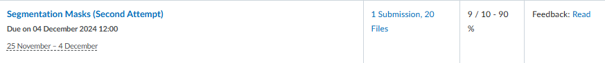
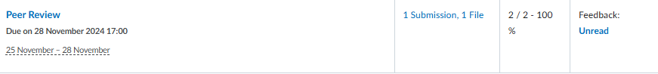
ILO 6
Data Collection and Processing
The student masters (technological) skills to acquire, pre-process, process and manage the necessary data to create value for individuals, organizations and domains.
1/1
6.4
Image Data. The student demonstrates the ability to collect, label, and process image data.
pre-requisites | A: 5 points | B: 3 points | C: 2 points
Student submitted a complete learning log, work log and self-assessment rubric. | The student accurately annotates images for object detection or image segmentation and provides constructive feedback on the quality of peer annotations, in line with client requirements. | The student demonstrates the ability to load, display, and save images, convert between color spaces, and perform basic image manipulations such as resizing, cropping, or rotating. The student demonstrates the ability to perform intermediate image manipulations such as annotating with shapes, overlaying text, and applying masks to isolate regions, in line with client requirements, using industry standard tools. | The student demonstrates the ability to filter images for noise reduction and image enhancement; apply thresholding, edge, and contour detection. The student demonstrates the ability to execute morphological operations on images; combine various traditional computer vision methods effectively to build image segmentation and object detection pipelines without machine learning, in line with client requirements, using industry standard tools.
self_assessment-rubric , Working_log Task 2 , Task_4 Task_1_requirements, Task 3 | I annotated images for segmentation tasks and provided feedback on peer annotations, ensuring they met the client’s accuracy and quality requirements. | I performed image processing tasks like loading, displaying, and saving images, converting between color spaces, and basic manipulations such as resizing, cropping, and rotating. Additionally, I applied intermediate techniques like annotating with shapes, overlaying text, and using masks to isolate regions, ensuring they met client requirements using standard industry tools. Task_1_requirements, Task 3 , | I successfully filtered images for noise reduction and enhancement, applied thresholding, and performed edge and contour detection. I also executed morphological operations like erosion and dilation to refine segmentation and built object detection pipelines using traditional computer vision methods, meeting client requirements with industry-standard tools. I made further iterations on task 4 that Is why I provided the notebook for it Task 2 , Task_4

Slide 37
ILO 8
8
Modelling
The student can apply modelling techniques including Machine Learning and AI to create value for individuals, organizations and domains.

Slide 38
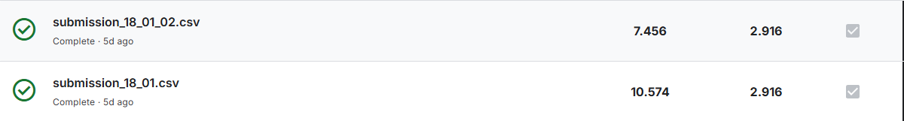
ILO 8
Modelling
The student can apply modelling techniques including Machine Learning and AI to create value for individuals, organizations and domains.
1/3
8.6
Computer Vision. The student demonstrates mastery in programming skills to acquire, pre-process, process, and manage digital images, alongside applying modeling techniques, including traditional computer vision and deep learning methods, to create value across various domains. Furthermore, the student is proficient in developing proof-of-concept solutions through an iterative cycle with explicit stakeholder involvement and can implement applications within existing architectures.
pre-requisites | A: 10 points | B: 20 points
Student submitted a complete learning log, work log, and self-assessment rubric, successfully labeled images as part of the project. Student presented their findings during the final block presentation. | The student demonstrates the ability to design and implement deep learning models for object detection or image segmentation using industry-standard deep learning frameworks, ensuring compatibility between neural network architecture and components in line with client requirements. | The student demonstrates the ability to design and implement end-to-end computer vision pipelines that merge data processing, traditional computer vision, and deep learning; iterate this pipeline towards an optimal solution using techniques such as transfer learning, hyperparameter tuning, data collections. The student demonstrates the ability to extract, process, and analyze quantitative information from images using appropriate algorithms and methods that are in or outside of the computer vision domain. Meanwhile, the student tracks these iterations with industry-standard experiment tracking tools. The student demonstrates the ability to deliver an optimal computer vision solution, in line with client requirements.
Model_1 , model 2 model 3 , self_assessment-rubric , Working_log , Inference , unet_model_3, unet_model_2, unet_model_4 submission_18_01_02, submission_18_01, Task 8 best submission , task 8 second best submission | I met the requirements by successfully training a U-Net model that combines datasets Y2B_23 and Y2B_24. I implemented the training process in the provided notebook), adhering strictly to the client’s instructions. Specifically, I used only the designated “val_…” images from Y2B_24 as my validation set, ensuring no overlap with the training data. My validation F1 score exceeded the 0.5 threshold and approached the desired 0.8 level. Additionally, I delivered an inference notebook that accepts raw images and produces binary mask outputs, as well as a saved trained model file and a predicted mask for the test image, all named according to the required templates. model 3 - 82 unet_model_4 Inference | I met the criteria by building a complete computer vision pipeline that incorporated multiple models and data processing steps. I successfully integrated preprocessing, inference, and post-processing into a cohesive workflow, ensuring that the pipeline produced accurate primary root length measurements. Additionally, I iterated on the pipeline through various experiments, using segmentation models, and tracked my progress with industry-standard experiment tracking tools like . This allowed me to deliver an optimal solution that aligned with client requirements. unet_model_3- 82 unet_model_4 – 82 submission_18_01_02 – 7.456 submission_18_01 - 10.574 Task 8 best submission task 8 second best submission

Slide 39
ILO 8
Modelling
The student can apply modelling techniques including Machine Learning and AI to create value for individuals, organizations and domains.
2/3
8.7
Robotic Control Theory with Computer Vision. The student is able design, implement, and evaluate control algorithms, while implementing computer vision techniques for perception in order to address the business objective.
pre-requisites | A: 2 points | B: 3 points | C: 4 points | D: 3 points | E: 3 points
Student submitted a complete learning log, work log and self-assessment rubric. Clear contribution to this ILO is documented in the learning log. Student presented their findings during the final block presentation. | The student identifies relevant environmental input required for situational awareness. Selects and uses appropriate frameworks for the chosen control algorithm. Instructions for environment setup, including a list of libraries used, are contained in a README.md file on GitHub. | The student demonstrates the ability to set up a robotic simulation environment, send commands to a simulated robot, and receive sensor data for processing and situational awareness. | The student demonstrates the ability to create a controller using traditional control theory. The controller must be able to control a robotic manipulator as described in the creative brief. The controller can use co-ordinates as input. A GIF of the working model is presented on GitHub. | The student demonstrates the ability to integrate a computer vision pipeline into the robotic controller to determine the required co-ordinates according to the requirements in the creative brief. An animation of the working model is presented on GitHub. | The student demonstrates the ability to quanitfy the performance of the model according to appropriate performance criteria. The robot controller can respond to different situational conditions using formal logic. The entire code-base is well documented in a README.md file on GitHub.
self_assessment-rubric , Working_log , Read.me.file recorded video , Presentation , Pid runner , Pipeline compiuter vison for PID_Controller Gifs for Robotics | I successfully passed this criterion by clearly explaining how to access and utilize the sim_class in my project. This included detailing the necessary steps to set up the environment and integrate sim_class functionality, with all relevant instructions and required libraries documented in the README.md file on GitHub.. , Read.me.file , Presentation , recorded video | I created a simulation environment where the PID controller processes inputs, sends commands, and receives sensor data, ensuring it meets the criteria for situational awareness and control. Pid runner PID_Controller Taks 9going all corners | The PID controller takes input from the computer vision pipeline, identifies the bottom root tip, and moves the robotic manipulator to the desired position accurately. The GIF shows it in action. Pid runner , PID_Controller Gifs for Robotics | The PID controller takes input from the computer vision pipeline, identifies the bottom root tip, and moves the robotic manipulator to the desired position accurately. The GIF next slide shows it in action. Pipeline compiuter vison for PID_Controller , PID_controller_for computer vison | I met the criteria across two separate files, achieving the client requirements for the PID controller's accuracy to 0.001 m. The entire codebase is well-documented in the README.md file on GitHub, ensuring clarity and usability. Pipeline compiuter vison for PID_Controller , PID_controller_for computer vison Pid runner PID_Controller , Read.me.file

Slide 40
Videos of Reinforcement Learning, PID_Controller and movement
Controller Task 9
RL Pipeline
PID_Controller

Slide 41
ILO 8
Modelling
The student can apply modelling techniques including Machine Learning and AI to create value for individuals, organizations and domains.
3/3
8.8
Reinforcement Learning. The student is able design, implement, and evaluate Reinforcement Learing algorithms in order to address the business objective.
pre-requisites | A: 2 points | B: 3 points | C: 4 points | D: 3 points | E: 3 points
Student submitted a complete learning log, work log and self-assessment rubric. Clear individual contribution to this ILO is documented in the learning log. Student presented their findings during the final block presentation. | The student identifies relevant environmental input required for reinforcement learning. Selects approriate frameworks for the chosen reinforcement learning algorithms. Instructions for environment setup, including a list of libraries used are contained in a README.md file on GitHub. | The student demonstrates the ability to create a custom reinforcement learning gym environment wrapper for the robotic simulation package according to the standard gym framework. The student demonstrates the ability to train a single reinforcement learning model to complete the robotics task described in the creative brief and test it against appropriate performance criteria. The model uses object co-ordinates as input. | The student demonstrates the ability to train and compare the performance of different reinforcement learning models, hyperparameters and reward functions in completing the task successfully. Model hyperparameters are documented in a README.md on GitHub. Performance during the training process as well as the end product is documented on GitHub. | The student demonstrates the ability to complete the task by integrating a computer vision pipeline in the reinforcement learning controller. All inputs used are realistic and appropriate for the task being addressed. The student demonstrates the ability to use an MLOps tool to track the training process and hyperparameter search. | The student trains and tests multiple computer vision reinforcement learning models. Detailed and critical perfomance comparisons are made between reinforcement learning models and traditional control theory. Suggestions for model improvement, real-world implementation, knowledge acquisition and decision-making are made. The entire code-base is well documented in a README.md file on GitHub.
Wrapper, Gifs for Robotics , Read.me.file , Presentation , recorded video , Training RL model script | I successfully passed this criterion by clearly explaining how to access and utilize the sim_class in my project. This included detailing the necessary steps to set up the environment and integrate sim_class functionality, with all relevant instructions and required libraries documented in the README.md file on GitHub.. , Read.me.file , Presentation , recorded video | I successfully passed this criterion by creating and implementing a proper wrapper for the robotic simulation environment. This wrapper facilitated sending commands to the simulated robot and receiving sensor data for processing, enabling effective situational awareness. wrapper | Reinforcement Learning ModelsI trained multiple reinforcement learning models, experimenting with various hyperparameters and reward functions. Performance during training and final results are documented in the README.md file on GitHub. All models are accessible on the GitHub page, and the next slide provides a detailed overview of them. Training RL model script , , Read.me.file | Integrated Computer Vision and Reinforcement LearningI successfully integrated a computer vision pipeline into the reinforcement learning controller, using realistic and task-appropriate inputs. The training process and hyperparameter search were tracked using an MLOps tool. The previous slide contains a GIF showcasing the integration in action, though further improvements are still needed I don’t have a shape that is matching and still making some problems when dropping the chemical. Task_13_Rl pipeline , CV pipeline for Rl model | I trained and tested several reinforcement learning models in the environment. After critical performance analysis, I stopped at the second model as it successfully met the client’s requirements. The full code-base, including documentation, is available in the README.md file on GitHub. , Read.me.file , Rl _tester for models Training RL model script , wrapper

Slide 42
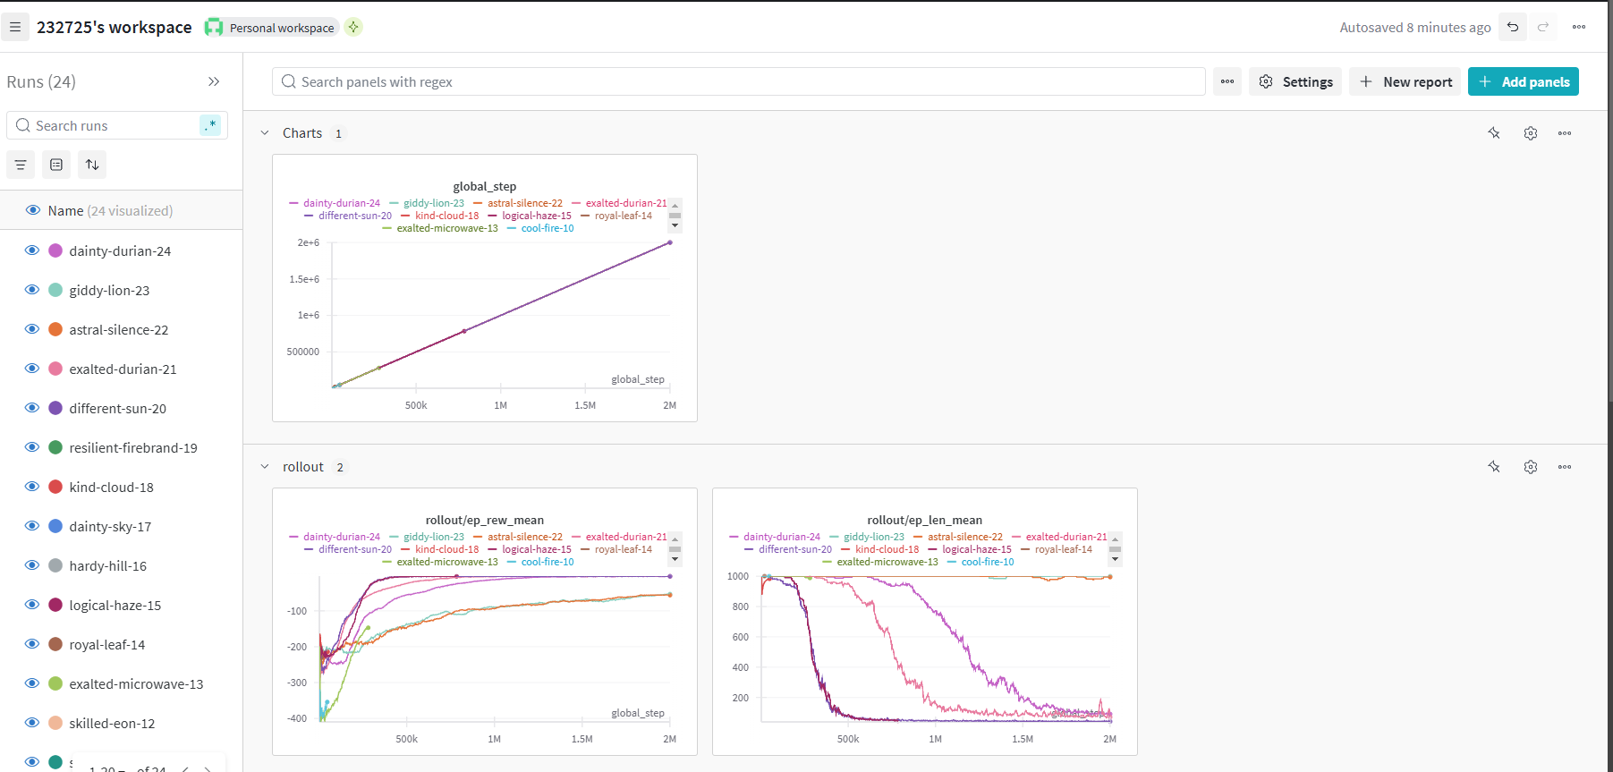
Rl models training

Slide 43

Medal Challenges
Going the extra mile!

Slide 44
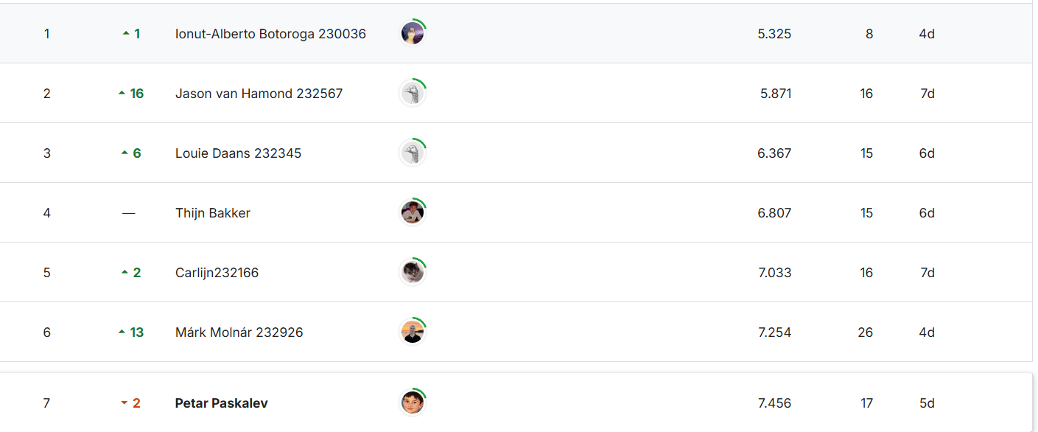
Medal Challenges
Going the extra mile!
1/1
Put your evidence down here to receive a medal!
Show your best examples, do not go overboard, add in short description, you are free to alter this layout (or add slides per evidence) to suit your needs. Just be sure that it is clear.
I tried really hard this block to achieve some of the medal challenges but was not quite there.
Third place was medal and I was 7th

Slide 45
Section D
D
Reflection
Notes:
MUST BE COMPLETED IN WEEK 8
Summative reflection on your progress during the block including a critical assessment of everything you did and learned during the block. This is a comprehensive review of everything recorded in Section B, evaluated against the goals and planning laid out in Section A.

Slide 46
D
What did I achieve this block?
1/2
My most significant achievements this block
For 3 weeks did almost the entire block
My most difficult challenges this block
Definetely Robotics as well as task 4 the prepartion for training the model there was some minor issues I need to fix every time
The most important lessons I learned
To never give up and continue going also to be a little bit delusional helps a lot.

Slide 47
D
How well am I progressing?
2/2
Reflection on my self assessment My self assessment grade is a
9.8
I did really good this block even tho my start was slow I managed to pass the block
How I plan to improve next block
Searching more than just doing the things sometimes it helps way more especially when the task is very diffucult

